Slide 1
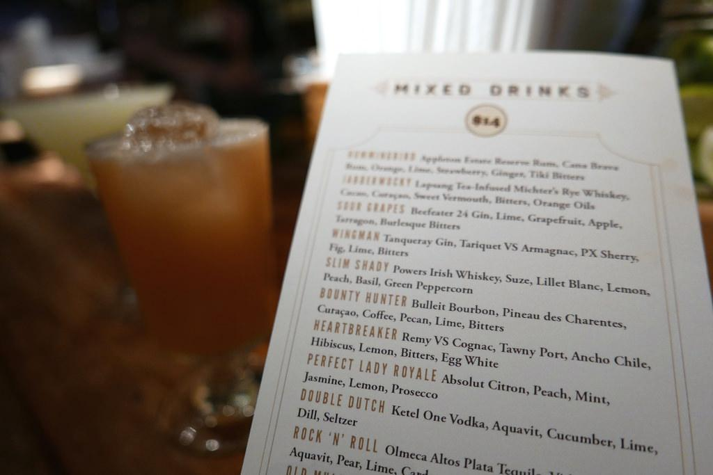
Cocktail Cookbook
Max McElligott, Max Harendza, Alex Paratore, Brendan Getts, Joey David

Slide 2
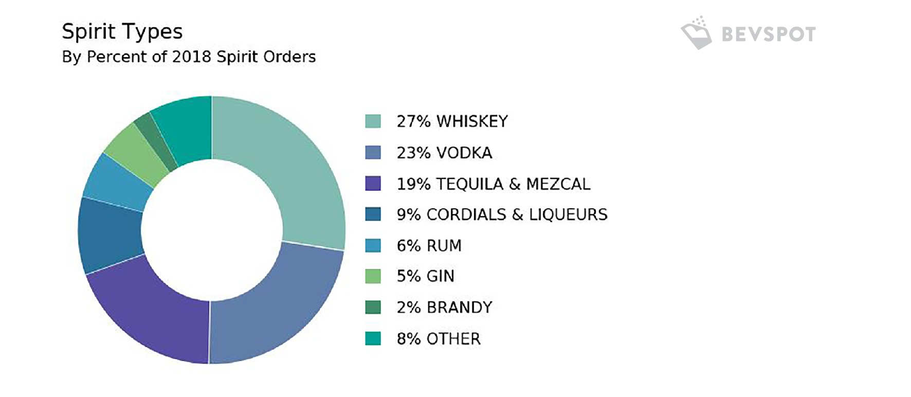
Layout of Home Page
4 Main Liquors:
Vodka
Rum
Whiskey
Tequila
Covers ~75% of Spirit Sales

Slide 3
4 Simple Cocktail Recipes
Base
Drink 1
Drink 4
Drink 2
Drink 3
Not overwhelming
Easy to navigate
Informative
Click to see recipe

Slide 4
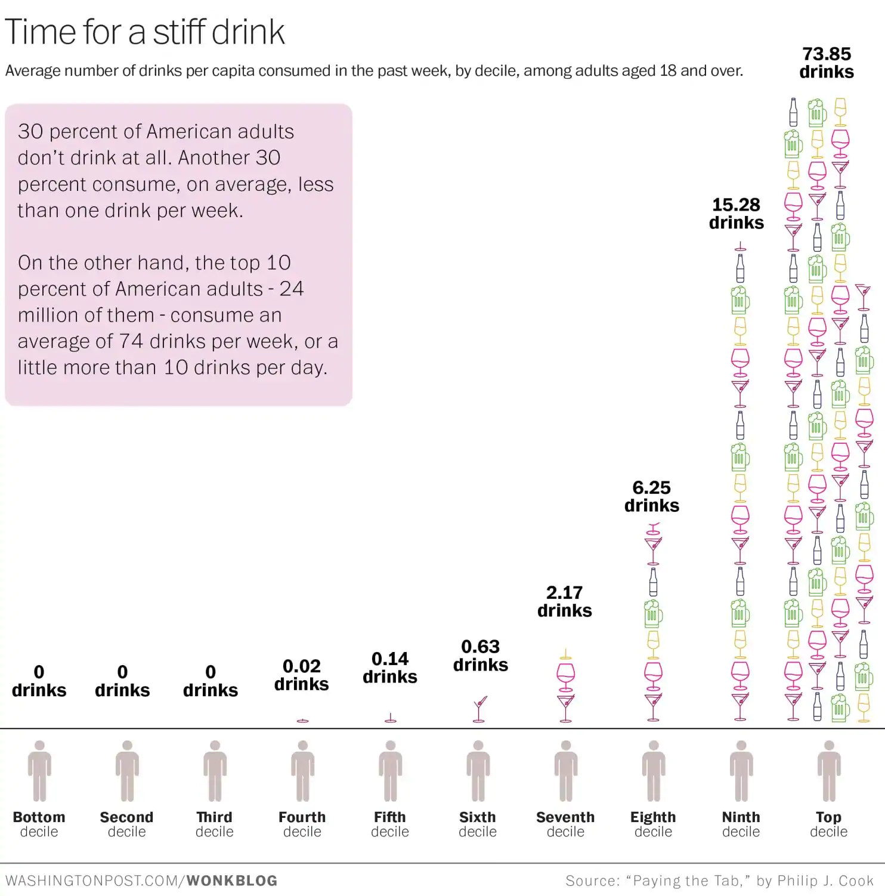
Educating the Average Person
Target Group
Ordering drinks when out
Trying out new drinks
Making drinks for friends/family
Having the correct ingredients for get togethers

Slide 5
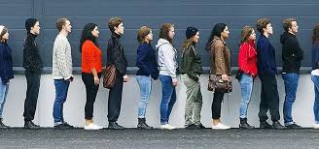
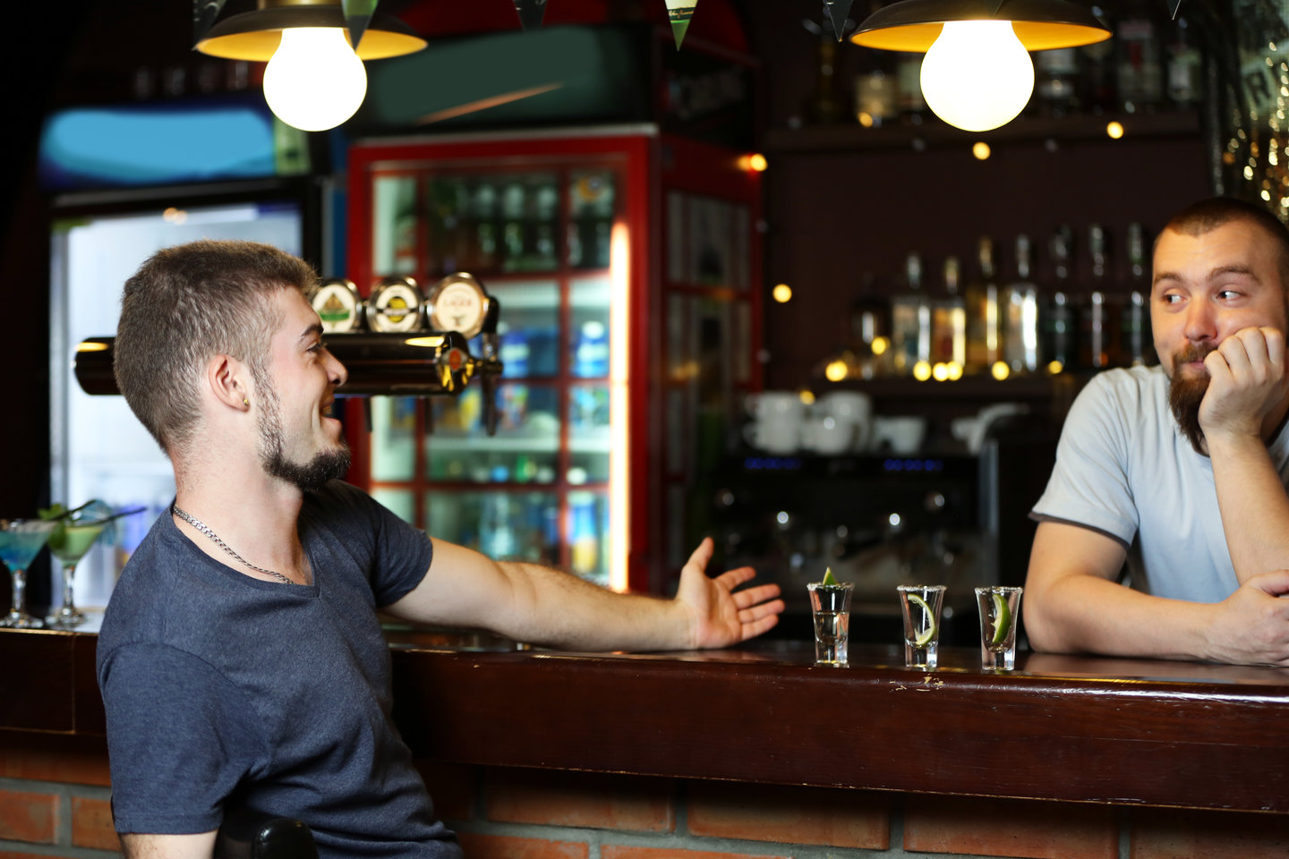
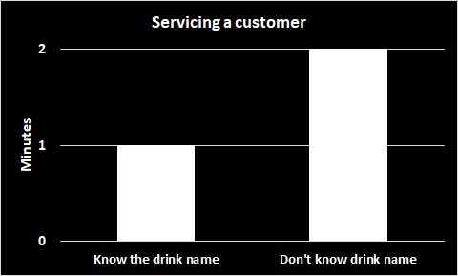
Bartenders
“Hey bro can I get one of those vodka drinks?”

Slide 6
Ideal Quality Attributes of Our System
Scalability: Limited scalability, unless expand to other categories
Availability: High
Reliability: High
Usability: Incredibly easy
Performance: Quick
Security: No user information needed.

Slide 7


Architecture
4 Components:
Navigation
Drink
Drinks
Landing
Angular in the front
ASP.NET

Slide 8
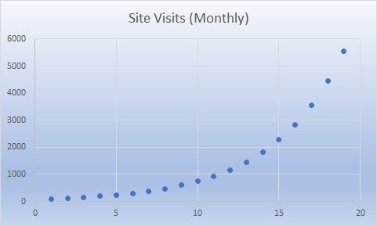
Judging Success
Number of users per day: Grow steadily through word of mouth
Issues: Retention (Most people will only visit a couple of times), No power users

Slide 9
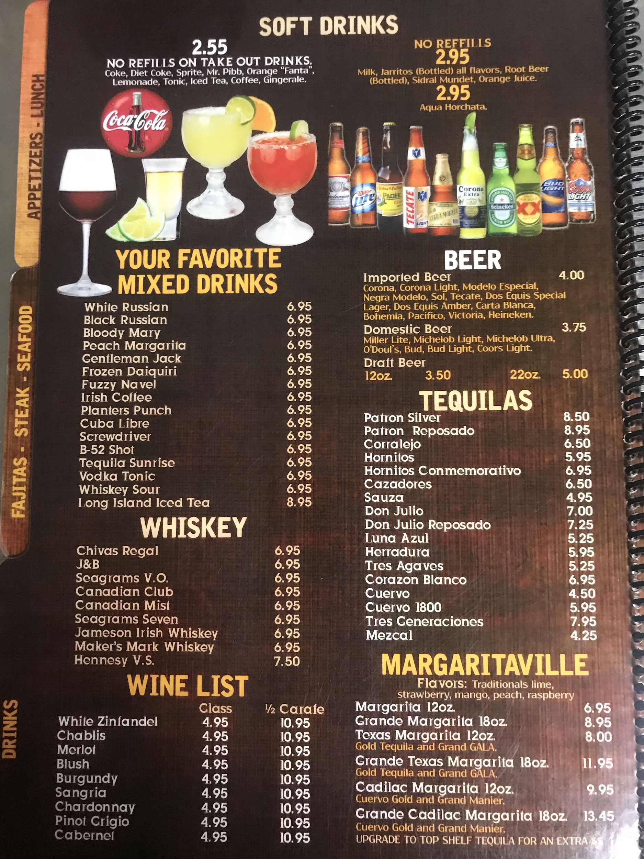
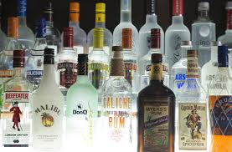
Future Goals
Advertisements on website
Partnerships with brands (Include brand in recipe)
Partnerships with restaurants/bars for an online drink menu

